Slide 1
Affordable and Clean Energy in the Context of Sustainable Development Scenario
Rajkiran V Bilolikar

Slide 2
What is Sustainability
According to the United Nations (the UN’s Brundtland Commission popularized the term in 1987), sustainability is defined as
“Meeting the needs of the present without compromising the ability of future generations to meet their own needs.”
True sustainability is when everyone, everywhere can meet their basic needs forever.

Slide 3
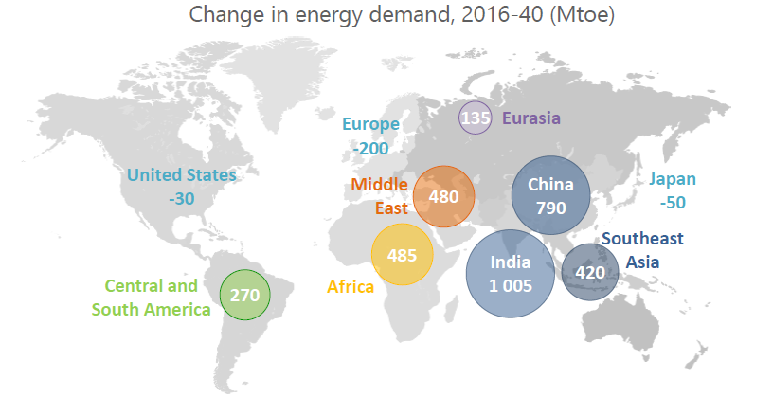
India takes the lead as China Energy Growth slows

Slide 4
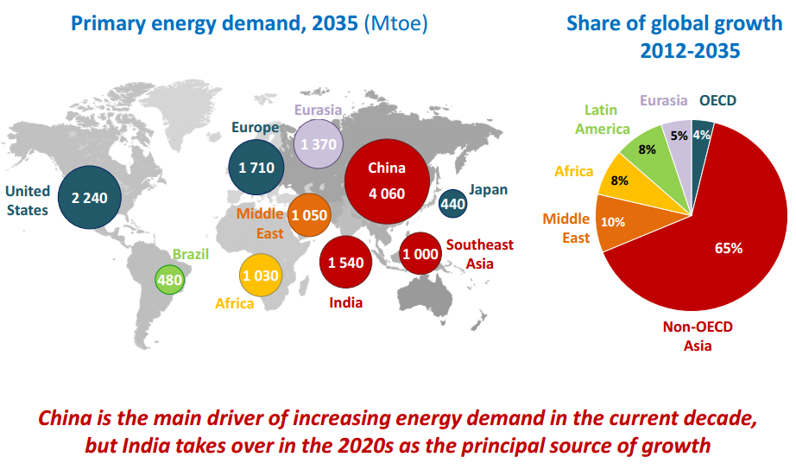

Slide 5
World Response - Scenarios and Projections
New Policies Scenario: A scenario in the World Energy Outlook that takes account of broad policy commitments and plans that have been announced by countries, including national pledges to reduce greenhouse-gas emissions and plans to phase out fossil-energy subsidies, even if the measures to implement these commitments have yet to be identified or announced. This broadly serves as the IEA baseline scenario.
450 Scenario: A scenario presented in the World Energy Outlook that sets out an energy pathway consistent with the goal of limiting the global increase in temperature to 2°C by limiting concentration of greenhouse gases in the atmosphere to around 450 parts per million of CO₂.
Efficient World Scenario: A scenario in the World Energy Outlook 2012 that presents the potential energy savings if countries adopt current and proven technologies to improve energy efficiency.
Source: World Energy Outlook 2012

Slide 6
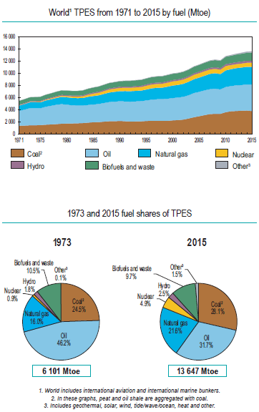
World’s Total Primary Energy Supply
A global economy growing at an average rate of 3.4% per year
A population that expands from 7.4 billion today to more than 9 billion in 2040,
And a process of urbanisation that adds a city the size of Shanghai to the world’s urban population every four months
- are key forces that underpin the earlier projections.
The largest contribution to demand growth – almost 30% – comes from India, whose share of global energy use rises to 11% by 2040

Slide 7
Projected changes in the Arctic by
2090-2100

Slide 8
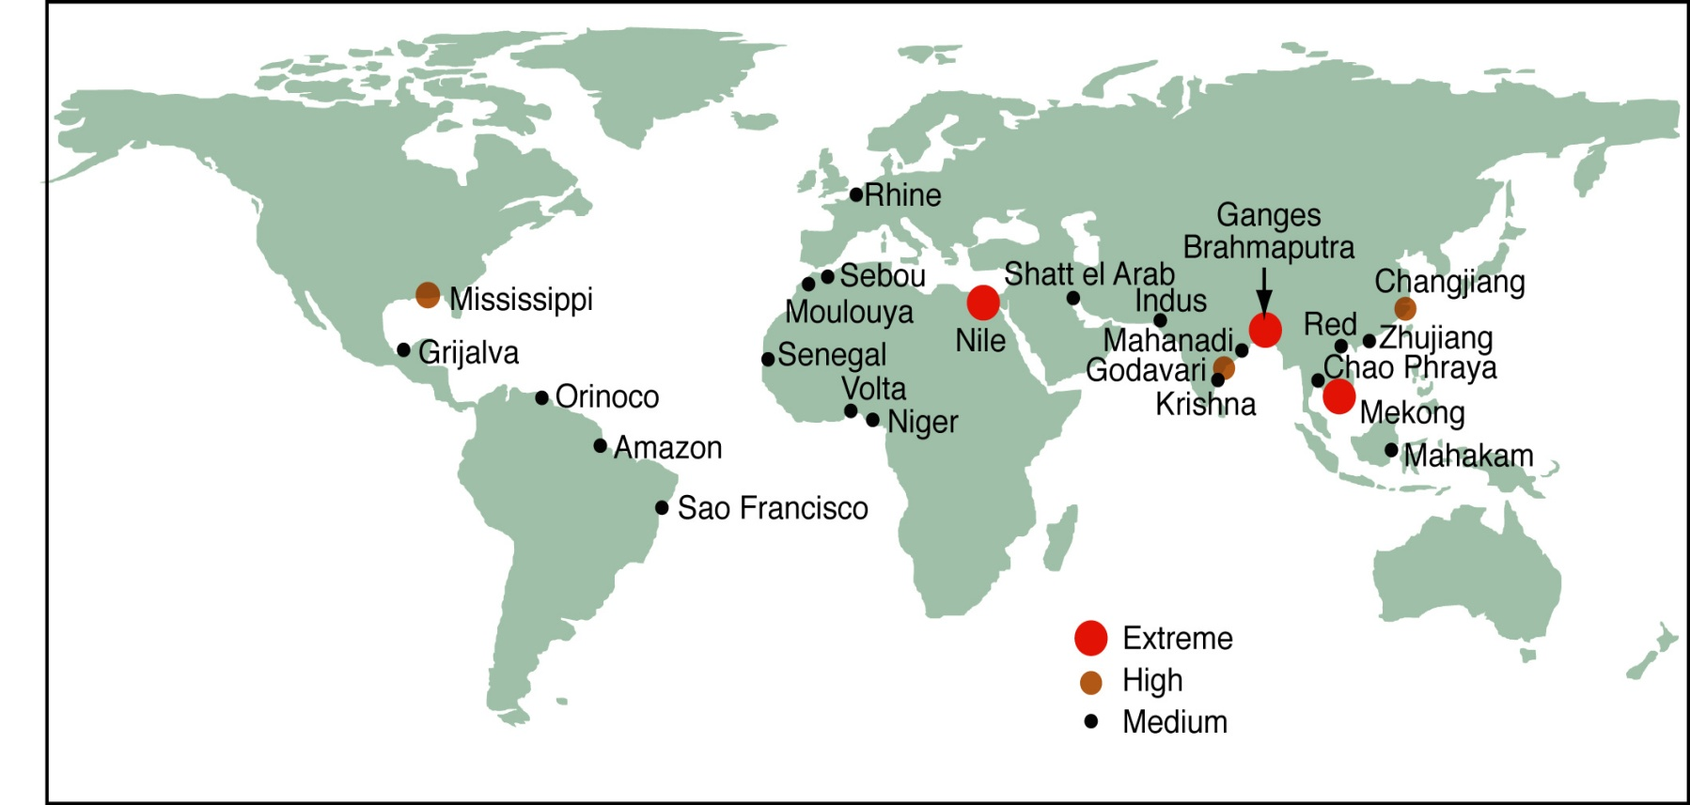
Threatened deltas
Relative vulnerability of coastal deltas as indicated by the indicative population potentially displaced by current sea-level trends to 2050 (Extreme > 1 million; high 1 million to 50,000; medium 50,000 to 5,000)

Slide 9
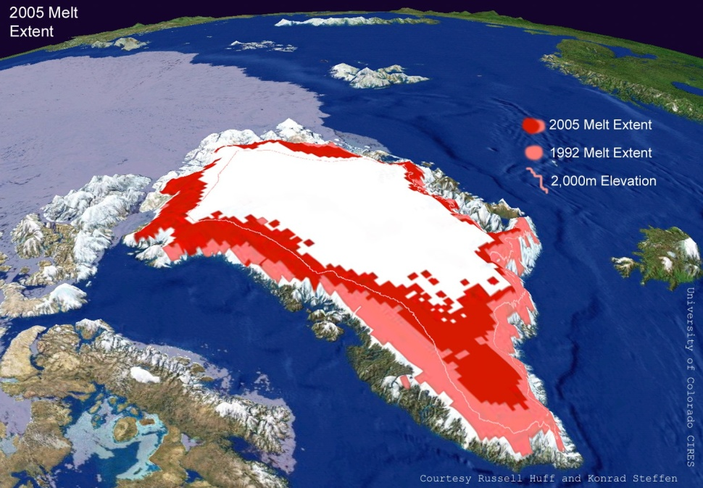
Sea level rise unstoppable
2100: 20 -60 cm
Many centuries: several meters
(WITHOUT melting Greenland/ Antarctica ice sheets)
1.5 to 4°C warmer for several centuries/ thousands of years: up to 7m increase from melting Greenland ice sheet
(like 125,000 years ago)

Slide 10
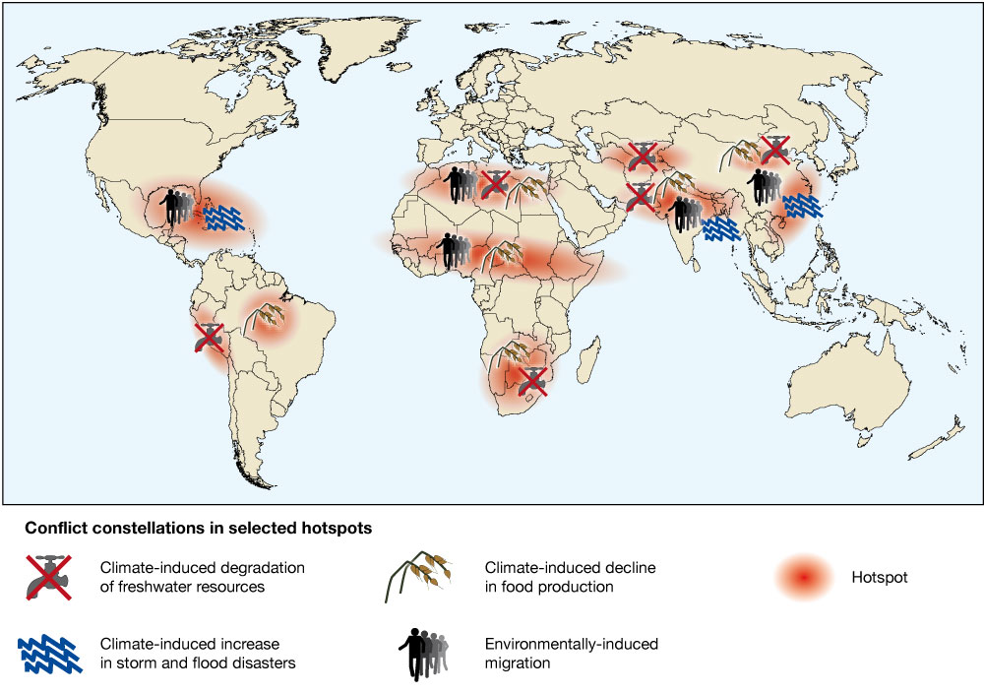
Security risks associated with climate change
Source:German Advisory Council on Global Change, 2007

Slide 11
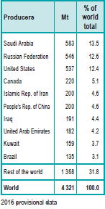
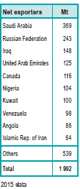
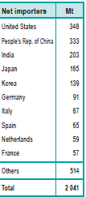
Crude Oil – Producers, Net Importers, Net Exporters

Slide 12
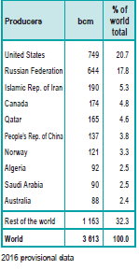
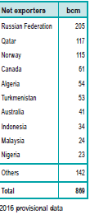
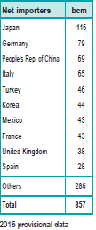
Natural Gas– Producers, Net Importers, Net Exporters

Slide 13
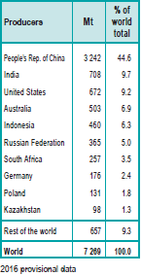
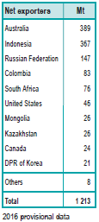
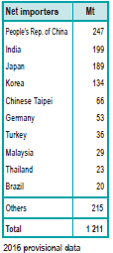
Coal– Producers, Net Importers, Net Exporters

Slide 14
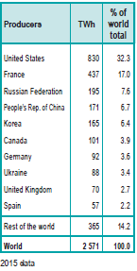
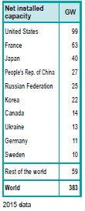
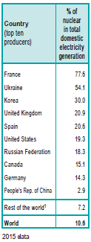
Nuclear– Producers and Installed Capacity

Slide 15
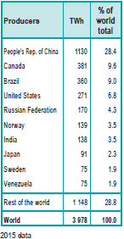
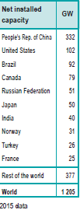
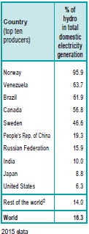
Hydro - Producers

Slide 16
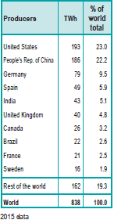
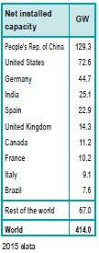
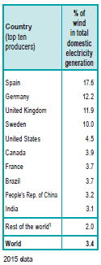
Wind - Producers

Slide 17
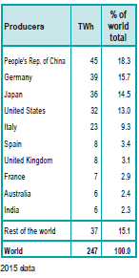
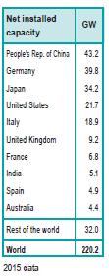
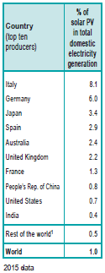
Solar – Producers of Solar PV

Slide 18




Electricity Generation by Source

Slide 19
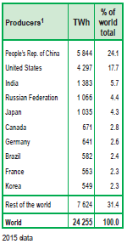
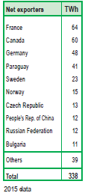
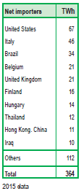
Electricity – Producers, Net Exporters and Net Importers

Slide 20
Power generation and installed capacity - India
INSTALLED CAPACITY (AS ON SEPTEMBER, 2019)
Power Generation | Actual Generation (as on August,19) | Units | Installed Capacity (as on September,19) | Units
Thermal | 80491.32 | GWh | 228601.42 | MW
Nuclear | 4162.15 | GWh | 6780 | MW
Hydro | 19844.76 | GWh | 45399.22 | MW
TOTAL | 104498.23 |  | 280780.64
RE Generation | Actual Generation (as on August, 2019) | Units | Installed Capacity (as on September,19 | Units
Solar (as on Sept,19) | 3222.6 | MU | 30708.85 | MW
Wind (as on Sept,19) | 5125.9 | MU | 36750.42 | MW
Biomass /Cogen | 485.43 | MU | 9131.5 | MW
Waste to Energy | - | MU | 139.8 | MW
Small Hydro | 1120.46 | MU | 4608.81 | MW
Others | 25.09 | MU | -
TOTAL | 9979.48 |  | 81339.38
Grand Total | 114477.71 |  | 362120.02
Notes:
Reference:
http://cea.nic.in/reports/monthly/renewable/2019/renewable-08.pdf
http://cea.nic.in/reports/monthly/installedcapacity/2019/installed_capacity-09.pdf

Slide 21
Power generation and installed capacity - India

Slide 22
Indian Power Sector – Sustainability Issues
India's large reserves of coal are a major asset to the country, accounting for 70 percent of India's current production of electricity. However, excessive use of this form of energy production—especially without the use of strategies to mitigate its effects—will cause the quality of the country's air, land, and water resources to deteriorate. Specifically,
Small particles from combustion eventually reach the ground, threatening human health and property.
Disposing of the ash that is produced as a byproduct of combustion requires large amounts of land; leaching ash can contaminate ground water.
Carbon dioxide released from fuel by combustion contributes to global warming and climate change.
Power stations may require large, and frequently environmentally valuable, land areas.
Large hydro and coal projects require resettlement and rehabilitation, and affect people.
Acid gases that are produced when fossil fuels are burned are eventually precipitated as acid rain

Slide 23
What to do??
We must take full responsibility for reducing our reliance on fossil fuels
We must lead in developing and deploying the means of global growth that use energy more wisely than ever before
We must develop the energy efficient technologies that enable us and the rest of the world to do more and waste less in every walk of life from manufacturing and transportation to the way we power our shopping centres, ballparks and homes.
We must take responsibility for our historical role as the single largest source of the cumulative carbon pollution that is choking our atmosphere and disrupting global climate

Slide 24
The sustainable development scenario
The Sustainable Development Scenario,
a major new scenario introduced in the WEO-2017, outlines an integrated approach to
Achieve the energy-related aspects of the UN Sustainable Development Goals:
  Determined action on climate change;
  Universal access to modern energy by 2030; and
  A dramatic reduction in air pollution.

Slide 25
Sustainable Power Sector

Slide 26
Energy Sustainability Framework
Sustainable development, as defined by the Brundtland Commission, is development that meets the needs of the present generation without compromising the ability of future generations to meet their own needs
The framework for assessing sustainability in the electricity sector is based on the 3A’s energy sustainability objectives proposed by the World Energy Council (WEC) which are
Accessibility – is the provision of modern energy services at a socially affordable price for all. It has been argued in this regard that prices should reflect the true marginal costs of production, transmissions and distribution to enable utilities to maintain and develop energy services. Furthermore prices should reflect the external costs due to emissions and waste management
Availability - is related to long-term continuity of supply and short term quality of service. It is argued that a well diversified portfolio of domestic or imported traded fuels and energy services is required in this regard. The key to achieve this is to keep all energy options open.
Acceptability – relates to public attitudes and the environmental impacts at the global and local levels. Climate change is the most serious longer-term environmental threat and arises from the use of fossil fuels. This sustainability dimension also includes social concerns regarding nuclear security

Slide 27
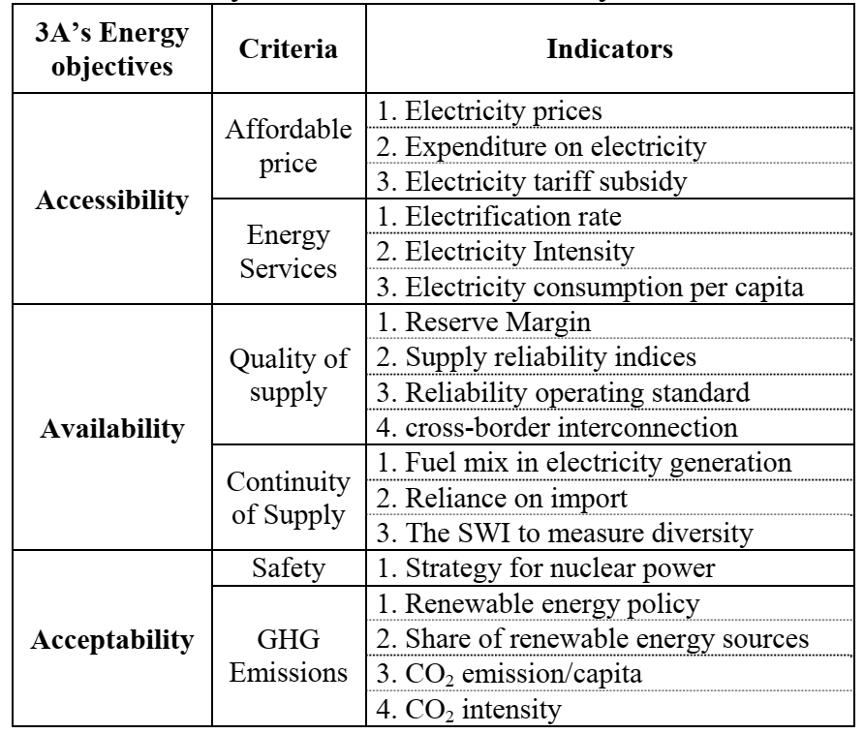
Selected Sustainability Indicators

Slide 28
Sustainable Development Goals
On 25–27 September, 2015, the UN General Assembly met to officially adopt the new Sustainable Development Goals (SDGs).
The 17 SDGs aim to establish a common framework for the policy and development agenda across the 193 UN member states, looking toward the year 2030.
The 17 SDGs have been developed through an extensive public consultation process, and are intended to serve as goals which developing and developed countries can achieve together.
The seventh SDG is to “ensure access to affordable, reliable, sustainable, and modern energy for all”.

Slide 29

SDG 7 – Clean Energy
By 2030 ensure universal access to affordable, reliable, and modern energy services
Increase substantially the share of renewable energy in the global energy mix by 2030
Double the global rate of improvement in energy efficiency by 2030
By 2030 enhance international cooperation to facilitate access to clean energy research and technologies, including renewable energy, energy efficiency, and advanced and cleaner fossil fuel technologies, and promote investment in energy infrastructure and clean energy technologies
By 2030 expand infrastructure and upgrade technology for supplying modern and sustainable energy services for all in developing countries, particularly LDCs and SIDS

Slide 30
Policy Base for RE Promotion
Why Renewable?
Increase Energy Security
Reduce the adverse impacts on local environment
Lower its carbon intensity
Balanced regional development
Realise its aspiration for leadership in high-technology industries

Slide 31
Why Renewable?
Key factors that will drive this market include :
High Energy deficit – The Energy deficit in the country is alarming due to heavy imports and expected to persist over the next decade
Rising Import dependence - Import dependence is currently at almost 30% of our energy requirements and could rise to 59% in a worst case scenario by 2032
Favorable economics - At present, the variable cost of power from diesel based generation is upwards of INR 15 per unit. Solar/Wind power are already significantly less. These sources have already turned economical for certain commercial/ industrial customers at their levelized utility tariffs
Benefits of distributed generation - By encouraging renewable power at consumer end (easy to generate at consumption point), network related investments and losses can be minimized.

Slide 32
Climate Change
  To meet our commitments to reduce carbon intensity, the use of renewable energy is indispensable
  Power sector contributes nearly half of the country’s carbon emissions
  On average every 1 GW of additional renewable energy capacity reduces CO2 emissions by 3.3 million tones a year
  Local ancillary benefits in terms of reduced mortality and morbidity from lower particulate concentrations are estimated at 334 lives saved /million tons of carbon abated

Slide 33
RE Development
  Renewable energy development can also be an important tool for spurring regional economic development, particularly for many underdeveloped states, which have the greatest potential for developing such resources.
  It can
    Provide secure electricity supply to foster domestic industrial development,
    Attract new investments,
    Serve as an important employment growth engine,
    Generate additional income

Slide 34
Renewable Energy Programme - India
    India Started its renewable energy programme in 1981 - Establishment of Commission for Additional Sources of Energy
    Converted the same into Ministry of Non conventional sources of Energy resources in 1992
    In year 2006, it was renamed – Ministry of New and Renewable energy (MNRE)

Slide 35
Policy Base for RE Promotion
  Electricity Act 2003
    Section 86(1) of EA 2003 mandates SERC to
      “Promote Co-generation from Renewable Sources of energy by providing suitable measures for connectivity to Grid and sale of electricity to any person, and also specify, for purchase of electricity from such sources, a percentage of total consumption of electricity in the area of distribution licensee”
  National Tariff Policy
    Para 6.4 of the Tariff Policy stipulates
      “Pursuant to provisions of 86(1) (e) of EA 2003, Appropriate Commission shall fix minimum percentage for purchase of power from RE sources in the region and its impact on retail tariffs”

Slide 36
Policy Base for RE Promotion
  National Rural Electrification Policies (NREP) 2006
    Include provision of access to electricity to all households by 2009
    Quality and reliable power supply at reasonable rates
    For villages/habitations where grid connectivity is not feasible of cost effective, off-grid solutions based on stand alone renewable systems may be taken up
    Supports to achieve target of 10% renewable energy through RPO (Renewable Purchase Obligation)

Slide 37
Policy Framework for Promotion of Renewable Energy
  Industrial Policy
    MNRE is promoting medium, small, mini, micro enterprises for manufacturing and servicing of various types of RE systems and devices
    For setting up of an RE industry, industrial clearances as well as no clearance from CEA for power generation up to Rs. 1000 million
    RE power generation projects – five year tax holiday
    RE Equipment manufacturing – soft loans are available through IREDA
    Private sector companies can set up enterprises to operate as licensee or generating companies
    Customs duty concession is available for RE spares and equipment

Slide 38
Policy Framework for Promotion of Renewable Energy
  Joint Ventures Policy
    It’s a financial as well as technical collaboration and they are used by FIs
    Usually JVs are in the form of takeovers or strategic alliances
  Policies for small scale industries
    Does not exceed Rs. 10 million
    Not permitted more than 24% equity in its paid up capital from any industrial undertaking, foreign / domestic
    National Small Industries Corporation (NSIC) provides assistance

Slide 39
Policy Framework for Promotion of Renewable Energy
  Feed-in Tariff Policy
    It is a generic description of a policy that pays a price, a ‘tariff’ for the electricity generated by RE that is fed into or sold to the grid
    Transparent, comprehensible, equitable
  Renewable Purchase Obligation
  Renewable Energy Certificats

Slide 40
Applicability of Policy Instruments at various stages of Renewable Energy Market Development

Slide 41
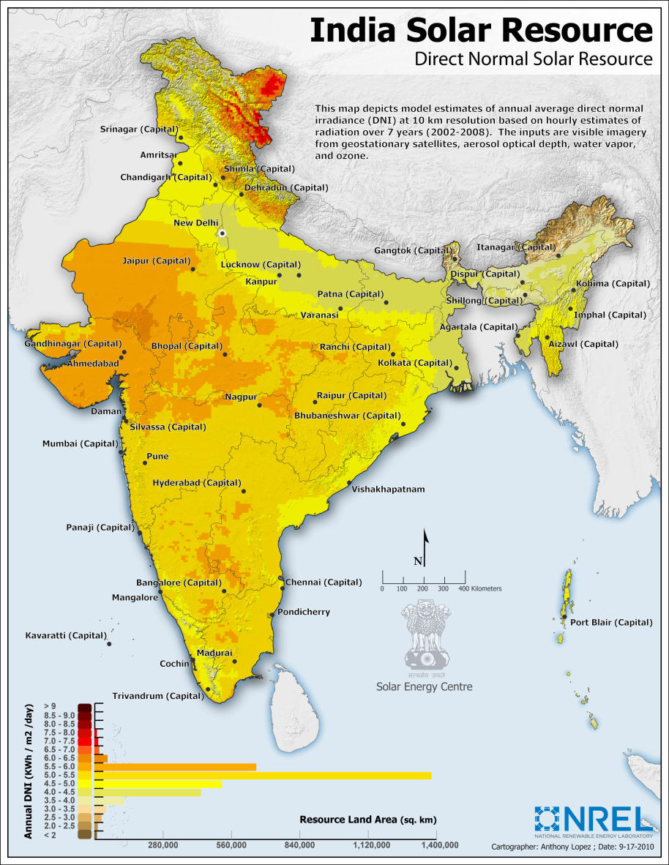
Solar Energy Overview
Particulars | Values
Solar Potential | 303 GW
Achievement (as on November,2017) | 7599.31 MW
Cumulative achievement (as on 30.11.2017) | 16611.73 MW
Cumulative Achievement (30.10.2018 | 24021.66 MW
Key points
Low Tariff for solar is Rs. 2.44/Unit
In 2017-18: 5525.98 MW (including 207.92 MW solar rooftop) was installed
1.42 Lakhs number of solar pumps have been installed as on 30.11.2017

Slide 42
Decline of Solar Tariff during recent times
Period | Capacity | Lowest tariff | Scheme | State / Project Name
February 2017 | 750 MW | 3.30 | State Scheme | Madhya Pradesh / REWA solar Park
May 2017 | 250 MW | 2.62 | VGF Scheme | Rajasthan / Bhadla IV Solar park
May 2017 | 500 MW | 2.44 | VGF Scheme | Rajasthan / Bhadla IV Solar park
August 2017 | 500 MW | 2.65 | State Scheme | Gujarat (Non Solar Park)

Slide 43
Solar Rooftop
MNRE is implementing Grid Connected Rooftop and Small Solar Power Plants Programme which provides CFA/ incentive in the residential, social, Government/PSU and Institutional sectors.
Under the programme, central financial assistance up to 30% of bench mark is being provided for such projects in Residential, Institutional and Social sectors in General Category States and up to 70% of the benchmark cost in Special Category States.
For Government sector, achievement linked incentives are being provided. Subsidy/CFA is not applicable for commercial and industrial establishments in private sector.
So far, sanctions for 1767 MWp capacity solar rooftop projects has been issued and around 863.92 MWp capacity has been installed.
All the 36 State / UT ERCs have now notified net/gross metering regulations and/or tariff orders for rooftop solar projects

Slide 44
Solar Rooftop . . . .
Concessional loans of around 1375 million US dollars from World Bank (WB), Asian Development Bank (ADB) and New Development Bank (NDB) have been made available to State Bank of India (SBI), Punjab National Bank (PNB) and Canara Bank for solar rooftop projects.
Suryamitra programme has been launched for creation of a qualified technical workforce and over 11,000 have been trained under the programme.
An online platform for expediting project, approval, report submission, and monitoring of RTS projects has been created.
Initiated geo-tagging of RTS projects, in co-ordination with ISRO, for traceability and transparency.
Launched mobile app ARUN (Atal Rooftop Solar User Navigator) for ease of access of beneficiaries for request submission and awareness.
MNRE has allocated Ministry wise expert PSUs for implementation of RTS projects in various Ministries/Departments.
Published best practices guide and compendium of policies, regulations, technical standards and financing norms for solar power projects.
Notes:
http://pib.nic.in/newsite/PrintRelease.aspx?relid=174832

Slide 45
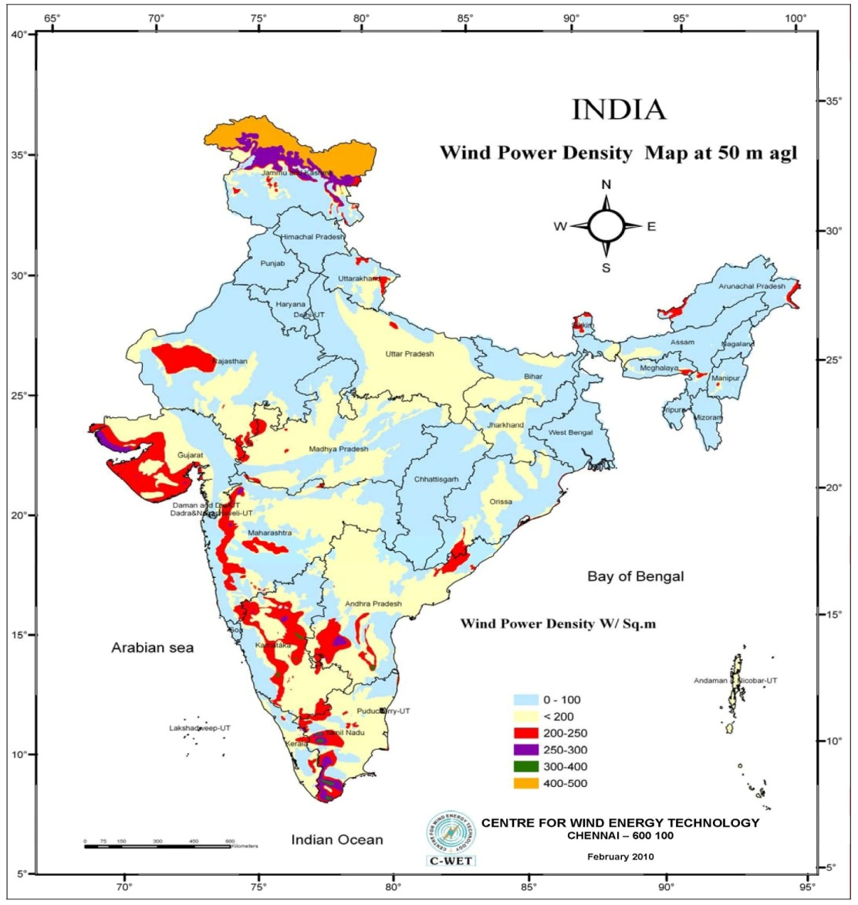
Wind Energy
Particulars | Values
Wind Potential | 100,000 MW (As per C-WET estimates at 80 m hub height)
Achievement
11th Plan Target Achievement (2007 – 2012) | 9,000 MW / 10260 MW
12th Plan Target Achievement (2012 – 2017) | 15,000 MW

Slide 46
Biomass Energy
Particulars | Values
Biomass Potential | 10 GW
Achievement (as on 30.10.2018) | 8730.80 MW
Grid interactive power | 60.95 MW
Off-Grid / Captive Power
Biomass (non-bagasse) Cogeneration | 7.5 MW (Gasifier)
Biomass Gasifier | 0.92
Biomass power includes installations from biomass combustion, biomass gasification generation making a cumulative achievement to 8181.70 MW
Bank loans up to a limit of Rs. 15 Crores will be given to borrowers for purposes like biomass based power generations and other renewable energy based utilities
Notes:
http://pib.nic.in/newsite/PrintRelease.aspx?relid=174832

Slide 47
Programmes for Biomass Energy
Biomass and bagasse cogeneration programme
Objectives
To promote efficient and economics use of surplus biomass for power generation
To maximize surplus power generation from sugar mills using improved technology
To promote technologies of co-generation and biomass combustion for supplementing conventional power.
To promote BOOT model projects for surplus power generation in cooperative sector sugar mills.
Programme components
Biomass based power generation in grid connected mode
Bagasse based cogeneration in sugar mills for export of surplus power to grid

Slide 48
Resources of biomass
For biomass power projects
  agro-based Industrial Residues,
  wood produced in Energy Plantations or recovered from wild bushes / weeds,
  wood waste produced in industrial operations;
  Crop / Agro industrial Residues
For Bagasse cogeneration projects
  Bagasse during crushing season

Slide 49
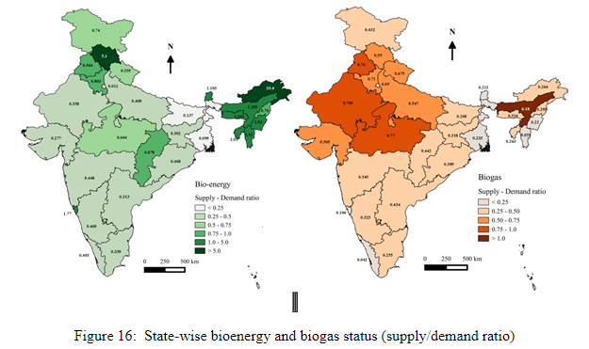
Biomass and Biogas Energy supply an demand ratio
Notes:
http://wgbis.ces.iisc.ernet.in/energy/paper/Energy-trajectory-in-India/Scope.html

Slide 50
Small Hydro
MNRE has created a database of potential sites of small hydro and 6,474 potential sites with an aggregate capacity of 19,749.44 MW for projects up to 25 MW capacity have been identified.
Estimated potential: 25,000 MW
Installed Capacity: 4506.95 MW (As on 30.10.2018)
Type | Use | Capacity (kW)
Water Mills | For local use | Up to 5
Micro | Village Electrification | Up to 100
Mini | Village Electrification & Grid | 101 to 2000
Small | Grid | 2001 to 25000
Notes:
http://npp.gov.in/public-reports/cea/monthly/installcap/2018/FEB/capacity1-2018-02.pdf
http://mnre.gov.in/small-hydro

Slide 51
Renewable Energy Programmes in INDIA
  Grid Interactive and Distributed renewable power
    Grid-Interactive (wind power, small hydro, biomass, urban & industrial waste to energy and solar power)
    Off-grid power system (small wind energy, Hybrid systems, Small hydro, Solar PV etc.)
  Rural & Decentralized Renewable power (such as family type biogas plants, Home lighting system, solar photovoltaic (SPV)/thermal program, wind pumps)
  Renewable Energy for Urban, Industrial & Commercial applications
  Research and Development in Renewables
  Other Programs (such as Energy Parks, Akshay Urja shops and Hybrid Vehicles)

Slide 52
Green Energy Corridor
Intra-State Transmission System is being implemented by eight renewable rich States (Tamil Nadu, Rajasthan, Karnataka, Andhra Pradesh, Maharashtra, Gujarat, Himachal Pradesh and Madhya Pradesh) with total project cost of Rs. 10141 crores, with funding mechanism consisting of 20% State Equity, 40% Government of India Grant (total 4056.67 crores) and 40% KfW loan (500 million EUR).
The project includes about approx. 9400 ckm transmission lines and Substations of total capacity of approx. 19000 MVA to be completed by March 2020.
The purpose is to evacuate approx. 20,000 MW of large scale renewable power and improvement of the grid in the implementing States.
Projects worth Rs. 6766 crore have been awarded and approx. Rs. 1400 crores have been disbursed to the States from the Government of India share.

Slide 53
Wind – Solar Hybrid Policy
Objectives
  To provide a framework for promotion of large grid connected wind-solar PV system for optimal and efficient utilization of transmission infrastructure and lad reducing the variability in renewable power generation and achieving grid stability
  To encourage new technologies, methods and way-outs involving combined operation of wind and solar PV plants
  To reach the wind-solar hybrid capacity of 10 GW by 2022
Notes:
http://mnre.gov.in/file-manager/UserFiles/Draft-Wind-Solar-Hybrid-Policy.pdf

Slide 54
Other Initiatives
India is taking a leading role in the International Renewable Community and was a leading country along with France in formation of International Solar Alliance (ISA), an international body of 121 countries lying between Tropic of Cancer and Tropic of Capricorn. 47 countries have signed the Framework Agreement and 18 countries have ratified it within 1 year of opening of Framework for signature. Accordingly, ISA became a legal entity on 6.12.2017, with its headquarters in India.
Bank loans up to a limit of Rs.15 crores will be given to borrowers for purposes like solar based power generators, biomass based power generators, wind power systems, micro-hydel plants and for renewable energy based public utilities viz. Street lighting systems, and remote village electrification. For individual households, the loan limit will be Rs.10 lakh per borrower.
Notes:
http://pib.nic.in/newsite/PrintRelease.aspx?relid=174832

Slide 55
Other Initiatives . . .
Foreign Direct Investment (FDI) up to 100% is permitted under the automatic route for renewable energy generation and distribution projects subject to provisions of The Electricity Act, 2003.
In order to achieve the targets, various initiatives have been taken by the Government which include:
  Announced a cumulative target of 175 GW renewable energy based electric installed capacity of 100 GW solar power installed capacity;
  Issued guidelines for procurement of solar and wind power through tariff based competitive bidding process
  Declared Renewable Purchase Obligation (RPO) up to the year 2018-19
  Declare Renewable Generation Obligation on new coal/lignite based thermal plants
  Notified National Offshore Wind Energy Policy

Slide 56
Other Initiatives . . .
  Notified policy for Repowering of Wind Power Projects;
  Notified standards for deployment of solar photovoltaic systems/devices
  Issued order for waiving the Inter State Transmission System charges and losses for inter-state sale of solar and wind power for projects to be commissioned by March 2019
  Launched Atal Jyoti Yojna for Solar LED Street Lights in five States; and
  Setting up of exclusive solar parks
  Identification of large government complexes/ buildings for rooftop projects
  Provision of roof top solar and 10 % renewable energy as mandatory under Mission Statement and Guidelines for development of smart cities

Slide 57
Other Initiatives . . .
  Amendments in building bye-laws for mandatory provision of roof top solar for new construction
  Infrastructure status for solar projects
  Raising tax free solar bonds
  Making roof top solar a part of housing loan by banks/NHB
  Raising funds from bilateral and international donors as also from the Green Climate Fund to achieve the target

Slide 58
The Future is Electrifying
Electricity is the rising force among worldwide end-uses of energy, making up 40% of the rise in final consumption to 2040 – the same share of growth that oil took for the last
twenty-five years.
Industrial electric motor systems account for one-third of the increase in power demand in the New Policies Scenario.
Rising incomes mean that many millions of households add electrical appliances (with an increasing share of “smart” connected devices) and install cooling systems.

Slide 59
The Future is Electrifying
By 2040, electricity demand for cooling in China exceeds the total electricity demand of Japan today.
The world also gains, on average, 45 million new electricity consumers each year due to expanding access to electricity, although this is still not enough to reach the goal of universal access by 2030.
Electricity makes inroads in supplying heat and mobility, alongside growth in its traditional domains, allowing its share of final consumption to rise to nearly a quarter.
A strengthening tide of industry initiatives and policy support – including recent decisions by governments in France and the United Kingdom to phase out sales of conventional gasoline and diesel vehicles by 2040 – pushes the projection for the global electric car fleet up to 280 million by 2040, from 2 million today.

Slide 60
Future is Electrifying
To meet rising demand,
China needs to add the equivalent of today’s United States power system to its electricity infrastructure by 2040, and
India needs to add a power system the size of today’s European Union.

Slide 61
When China Changes – everything changes
China is entering a new phase in its development, with the emphasis in energy policy now firmly on electricity, natural gas and cleaner, high-efficiency and digital technologies.
The previous orientation towards heavy industry, infrastructure development and the export of manufactured goods lifted hundreds of millions out of poverty – including energy poverty – but left the country with an energy system dominated by coal and a legacy of serious environmental problems, giving rise to almost 2 million premature deaths each year from poor air quality

Slide 62
When China Changes – everything changes
The president’s call for an “energy revolution”, the “fight against pollution” and the transition towards a more services-based economic model is moving the energy sector in a new direction.
Demand growth slowed markedly from an average of 8% per year
from 2000 to 2012 to less than 2% per year since 2012, and in the New Policies Scenario it slows further to an average of 1% per year to 2040.
Energy efficiency regulation explains a large part of this slowdown, without new efficiency measures, end-use consumption in 2040 would be 40% higher. Nonetheless, by 2040 per-capita energy consumption in China exceeds that of the European Union.

Slide 63
When China Changes – everything changes
One-third of the world’s new wind power and solar PV is installed in China in the New Policies Scenario, and China also accounts for more than 40% of global investment in electric vehicles (EVs).
China provides a quarter of the projected rise in global gas demand and its projected imports of 280 billion cubic metres (bcm) in 2040 are second only to those of the European Union, making China a lynchpin of global gas trade. China overtakes the United States as the largest oil consumer around 2030, and its net imports reach 13 million barrels per day (mb/d) in 2040.
But stringent fuel-efficiency measures for cars and trucks, and a shift which sees one-in-four cars being electric by 2040, means that China is no longer the main driving force behind global oil use – demand growth is larger in India post-2025.

Slide 64
EVs are coming fast, but it is still too early to write the obituary for oil
Globally, electricity consumed by EVs – including cars, two- and-three wheelers, and buses – is expected to double by 2022 but will still account for less than 1% of total electricity generation.
China is the largest consumer of renewable electricity in EVs, thanks to the expansion of two- and three-wheelers and the increasing share of renewables in its power mix.
The second-largest consumer is Europe due to the deployment of electric cars in markets with high shares of renewables such as Norway and Germany.
Despite the United States being the third-largest electric car market, renewable consumption is relatively lower than China and Europe because of the less prominent role of renewables in its electricity supply.

Slide 65
Thank You
Rajkiran V. Bilolikar,
Associate Professor, Energy Area,
Administrative Staff College of India,
Bella Vista, Raj Bhavan Road,
Hyderabad - 500082
T: +91 40 6653 4390
F: +91 40 6653 4356
M: +91 9704087888 rajkiran@asci.org.in

Slide 66
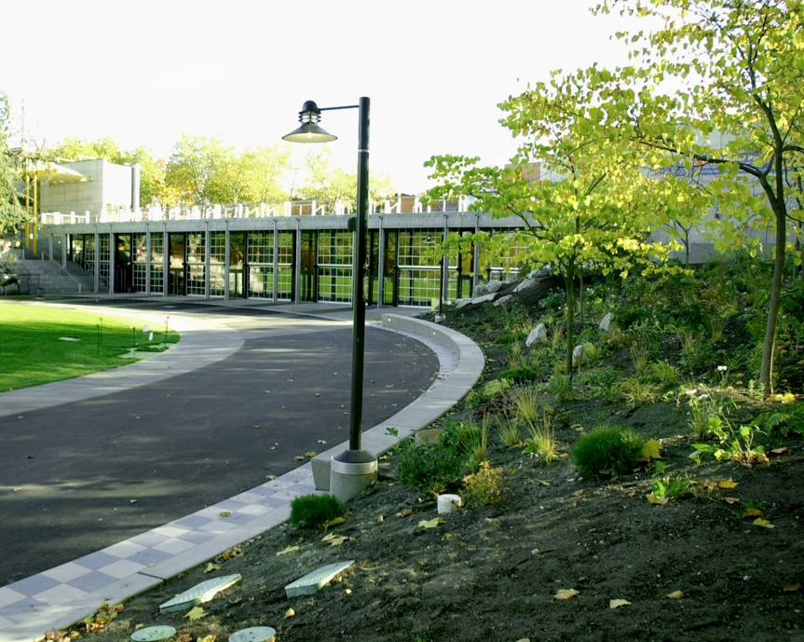
Green Building Movement – Case Studies
Fisher Pavilion
Seattle Center, Seattle, WA
Assembly
LEED-NC Certified
Sustainable Sites
  Stormwater management & erosion control
  Location / site selection
  Alternative transportation
  Habitat
  Microclimate
  Light pollution
58% STORMWATER RETAINED & INFILTRATED ON SITE

Slide 67
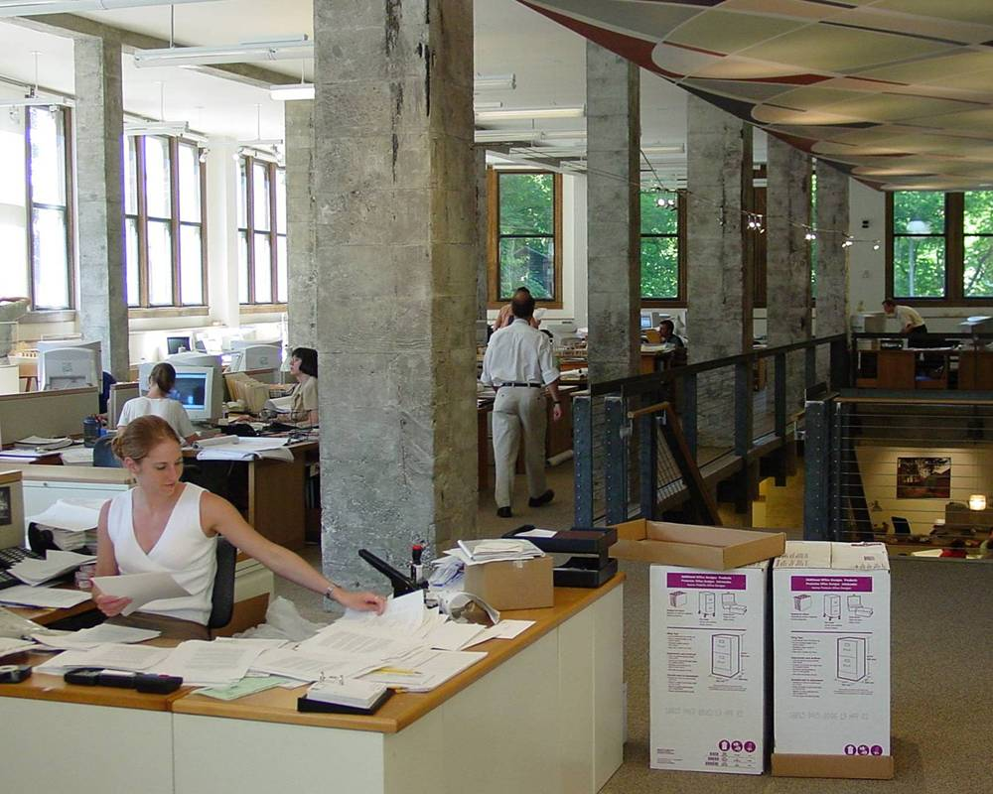
Green Building
Balfour Guthrie Building
Balfour Guthrie LLC, Portland, OR
Commercial Office
LEED-NC Silver
Energy & Atmosphere
  Performance measurement & verification
  Energy efficiency
  Renewable energy
  Ozone depletion
ENERGY PERFORMANCE 24% BETTER THAN CODE

Slide 68
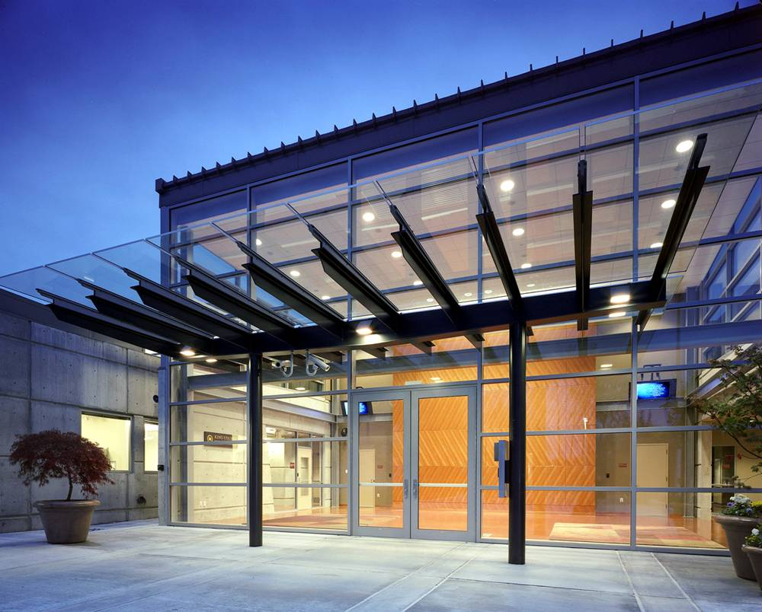
Green Building
Kent Pullen Regional Emergency & Communications Center
King County, Renton, WA
Public Safety
LEED-NC Certified anticipated
Materials & Resources
  Recycle
  Recycled-content
  Reuse
  Regionally manufactured
  Rapidly renewable
  Certified wood
RECYCLED 86% OF CONSTRUCTION & DEMOLITION WASTE

Slide 69
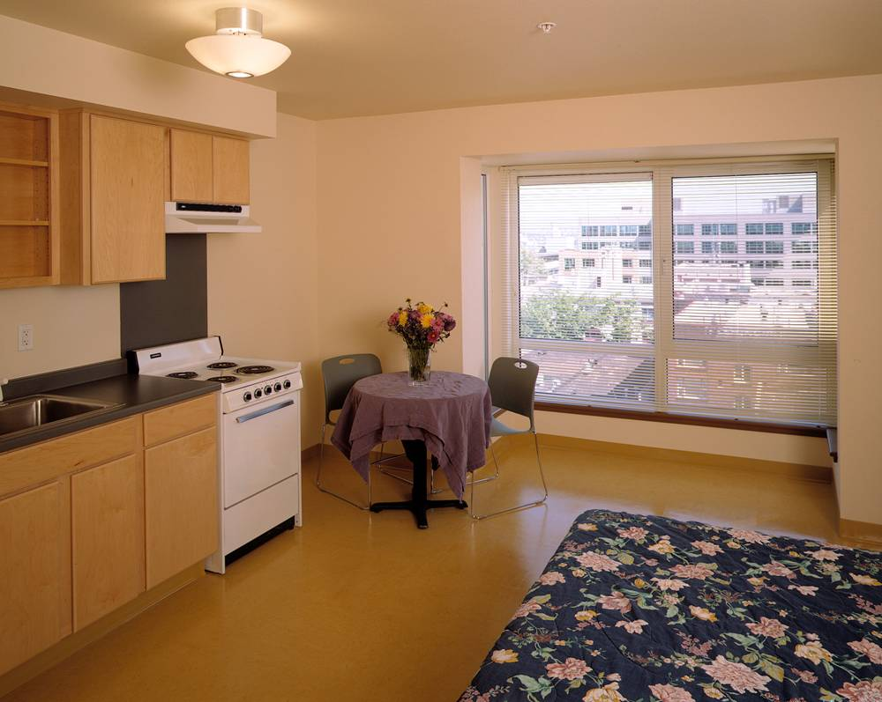
Green Building
Traugott Terrace
Catholic Community Services & Archdiocesan Housing Authority, Seattle, WA
Residential Low-Income Housing
LEED-NC Silver
Indoor Environmental Quality
  Construction management
  Source control
  Low-emitting materials
  Monitoring
  Ventilation
  Thermal comfort
  Daylight & views
PROVIDING A HEALTHY ENVIRONMENT FOR PEOPLE IN RECOVERY

Slide 70
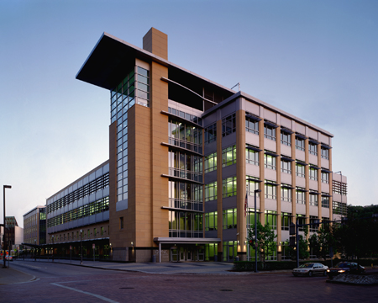
Benefits
PNC Firstside Center
PNC Financial Services Group, Pittsburgh, PA
Commercial Office
LEED-NC Silver
Higher ROI
  0–2% investment results in 20% life-cycle savings
  40% higher sales in stores with skylights compared to similar stores without skylights
— October 2003 report to California’s Sustainable Building Task Force
— California Board of Energy Efficiency Third Party Program
MET ROI CRITERIA OF 2 YEARS OR LESS
Notes:
Need to source each of the facts on all these business case slides (in small type at bottom of slide?)
Michael – here are the cites:
An October 2003 report to California’s Sustainable Building Task Force confirms that an upfront investment of 0 – 2% in green building design would on average, result in life cycle savings of 20% of the total construction costs – more than ten times the initial investment.
According to U.S. Environmental Protection Agency (EPA) research, tenants can save about 50 cents per square foot each year through strategies that cut energy use by 30%. This can represent a savings of $50,000 or more in a five-year lease on 20,000 square feet.
A study done for the California Board for Energy Efficiency Third Party Program found that sales in stores with skylights were up to 40% higher compared to similar stores without skylights.

Slide 71

Benefits
Toyota Motor Sales
South Campus Headquarters, Torrance, CA
Commercial Office Renovation
LEED-NC Gold
Higher NOI
  30% more energy efficient
  Generating a $0.50 / sq ft savings (EPA)
  30% more water efficient
  80% projects eliminate potable water for irrigation
— October 2003 report to California’s Sustainable Building Task Force
60% MORE ENERGY EFFICIENT THAN TITLE 24

Slide 72

Benefits
Harvard School of Public Health
Landmark Building, Boston, MA
Office Renovation
LEED-CI Pilot Project
Increased productivity
  7% increase in productivity following move to daylit facility
  Flexible design features cut employee relocation costs by 90%
— Studies conducted by Judith Heerwagen, Heerwagen & Associates
RECOVERED COSTS FOR GREEN FEATURES IN 10 MONTHS

Slide 73
“The Greenest Power is the power we don’t have to Produce..”
LET’S WALK THE TALK,
LET’S BE ENERGY EFFICIENT

Slide 74
Integration of innovation for large scale implementation – Smart Grid

Slide 75
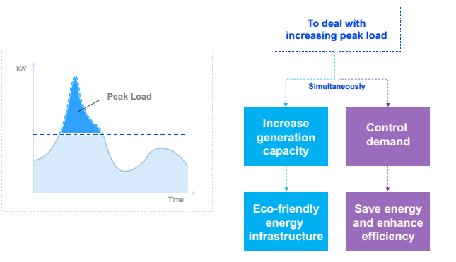
Future – Smart Grid

Slide 76
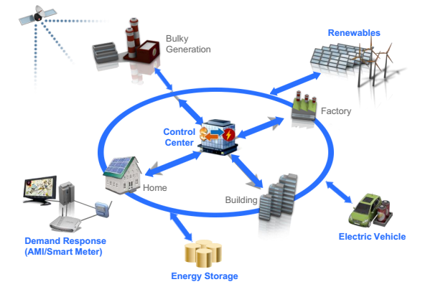
Smart Grid

Slide 77
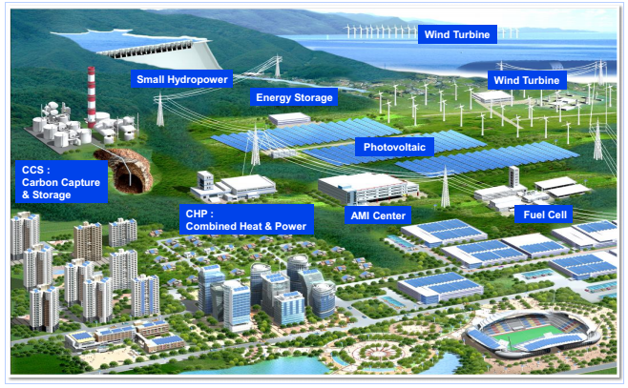
Distributed Energy Resources with Renewable

Slide 78
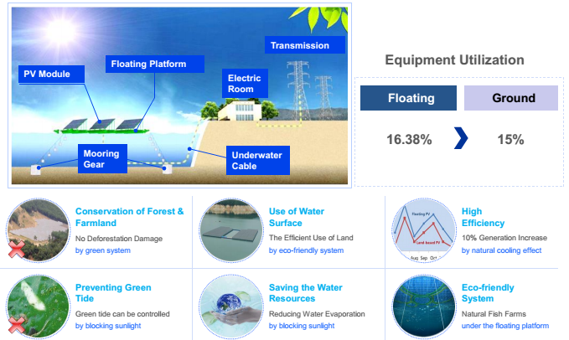
Water Floating PV

Slide 79
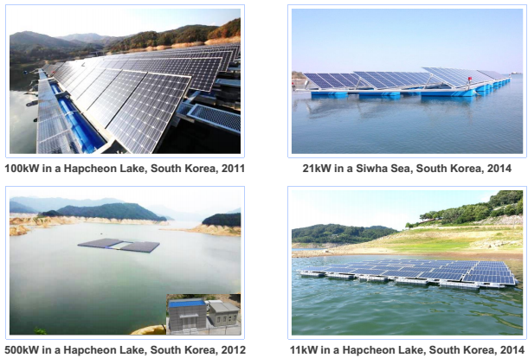
References of Floating PV in Korea

Slide 80
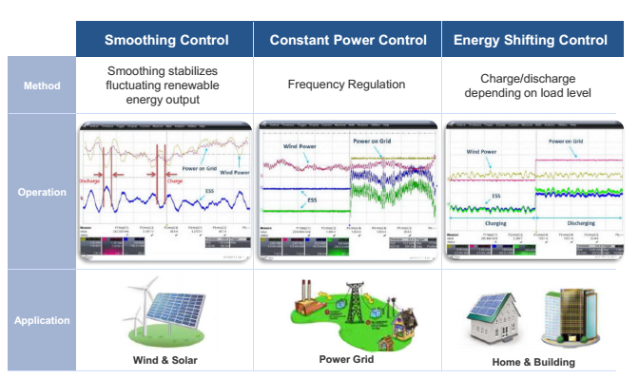
Energy Storage Systems (ESS)

Slide 81
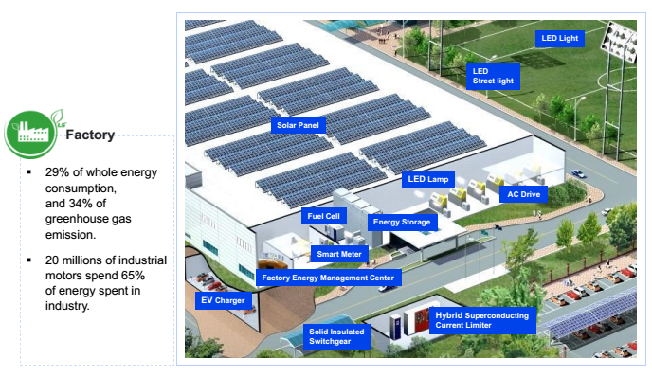
Factory Energy Management System (FEMS)

Slide 82
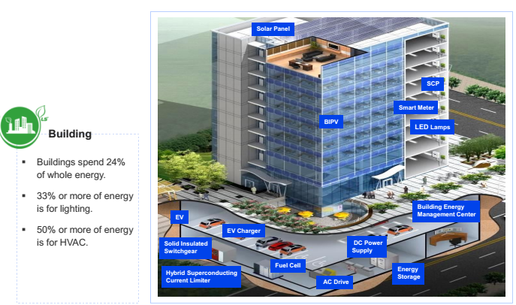
Building Energy Management System

Slide 83
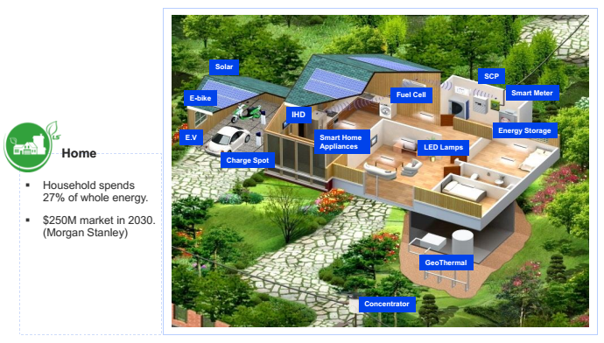
Home Energy Management System

Slide 84
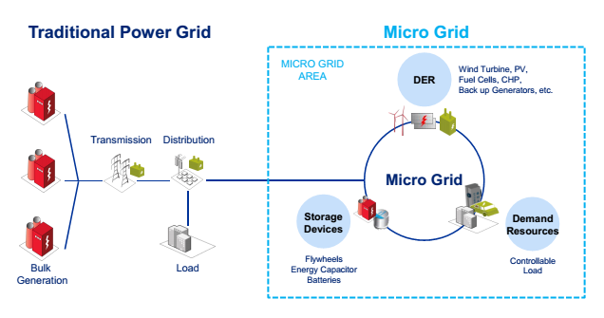
Micro –Grid Solution

